Slide 1
Basic Coding Course
Week 2 – Javascript – Data Types & Operators

Slide 2





Why Javascript?
Beginner-friendly
Its syntax is relatively straightforward, and it doesn't require complex setup or installations.
Versatile
It can be used both in web development (front-end and back-end) and for creating desktop and mobile applications
Real-Time Feedback
It allows you to see immediate results in the web browser's console.
Vibrant Ecosystem
Has a vast and active developer community. This means there are abundant resources, tutorials, and libraries available to help learners.

Slide 3
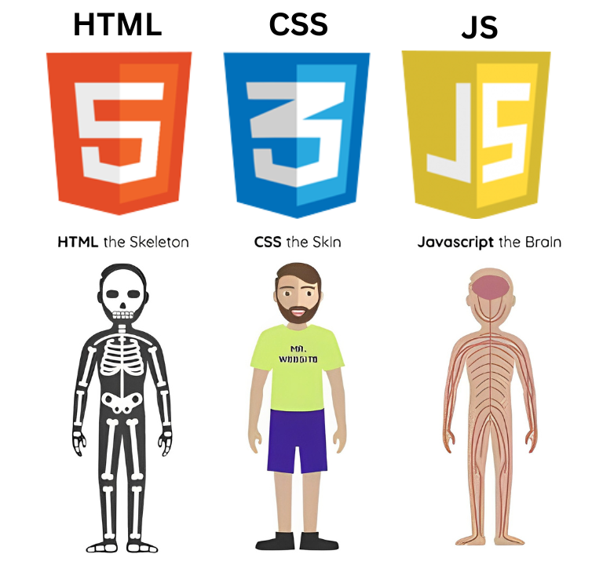
What is Javascript?
JavaScript is a high-level programming language that adds interactivity and dynamic behavior to websites. It allows you to create features like forms validation, and updating content without needing to reload the entire page. Even nowadays JavaScript can be use to build apps on the backend, mobile, and desktop.
JavaScript in Action:
Imagine a scenario where you visit a webpage and want to click a button that reveals additional information. JavaScript is what makes this possible. When you click the button, JavaScript code executes and modifies the webpage's content or behavior in response to your action.

Slide 4
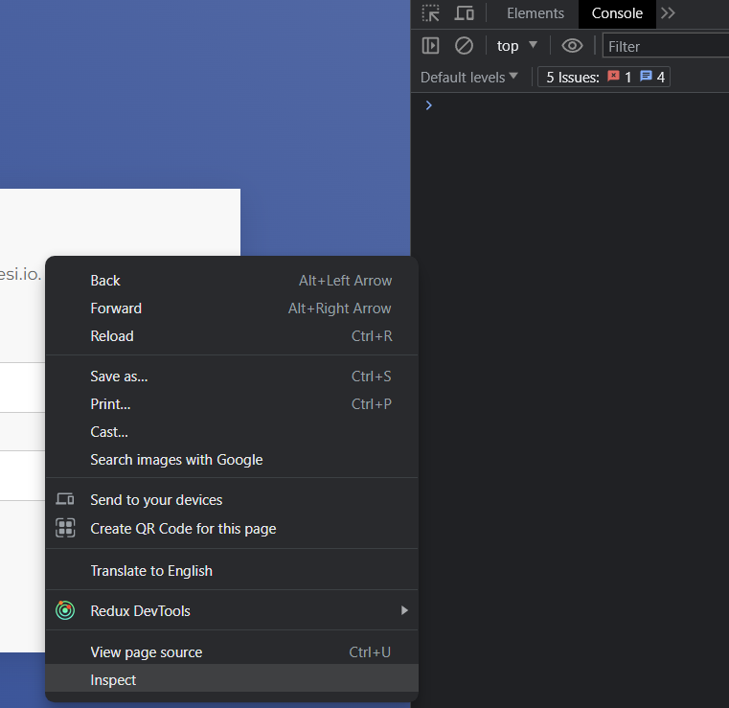
Developer Console
Chrome: Right-click on a webpage, select "Inspect," and navigate to the "Console" tab.
Firefox: Right-click, choose "Inspect Element," and go to the "Console" tab.
Safari: Go to "Preferences," click "Advanced," and check "Show Develop menu in menu bar." Then, use the Develop menu to open the console.
Edge: Right-click, select "Inspect," and go to the "Console" tab.

Slide 5
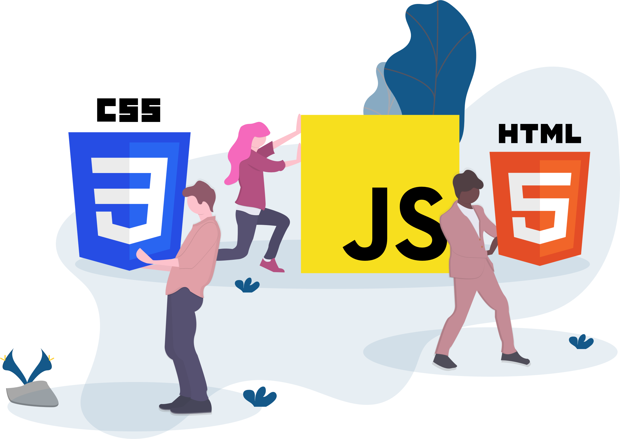
Variables
Section 1

Slide 6
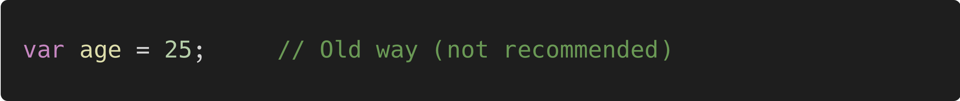
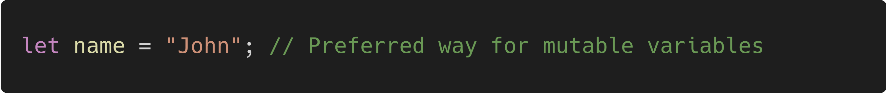
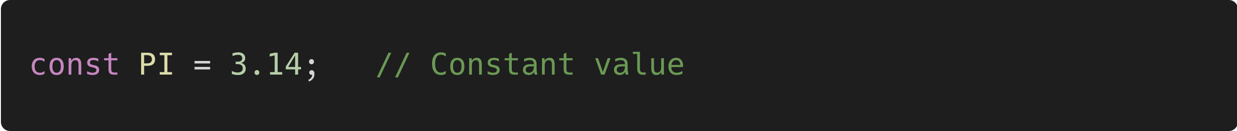
What is Variables?
Variables are used to store and manage data in a program. They give a name to a value so that it can be easily accessed and manipulated.
Declaring Variables
In JavaScript, you can declare variables using the var, let, or const keywords.
var: Used to declare variables with a broader scope (re-declarable and re-assignable).
let: Preferred for declaring variables with block-level scope (non re-declarable and re-assignable).
const: Used for declaring constants with block-level scope (non re-declarable and non re-assignable).

Slide 7
Variable Naming Rules
Case Sensitivity
JavaScript is case-sensitive. myVariable and myvariable are considered different variables.
Start with a Letter, Underscore, or Dollar Sign
Variable names must begin with a letter, underscore (_), or dollar sign ($). They cannot start with a number or other special characters.
Consist of Letters, Digits, Underscores, and Dollar Signs
After the initial character, variable names can include letters, digits, underscores, and dollar signs.
No Spaces or Special Characters (except Underscore and Dollar Sign)
Variable names cannot contain spaces or special characters like !, @, #, %, etc.
Cannot Be a Reserved Keyword
You cannot use reserved keywords (like if, else, for, while, function, etc.) as variable names.
Meaningful and Descriptive:
Choose variable names that are meaningful and describe the purpose of the variable. This enhances code readability.
Camel Case or Snake Case for Multi-Word Names
For variable names with multiple words, use camel case, where each word after the first is capitalized (e.g., myVariableName, full_name).

Slide 8
Data Types
Section 2

Slide 9
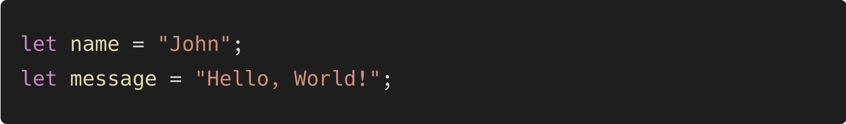
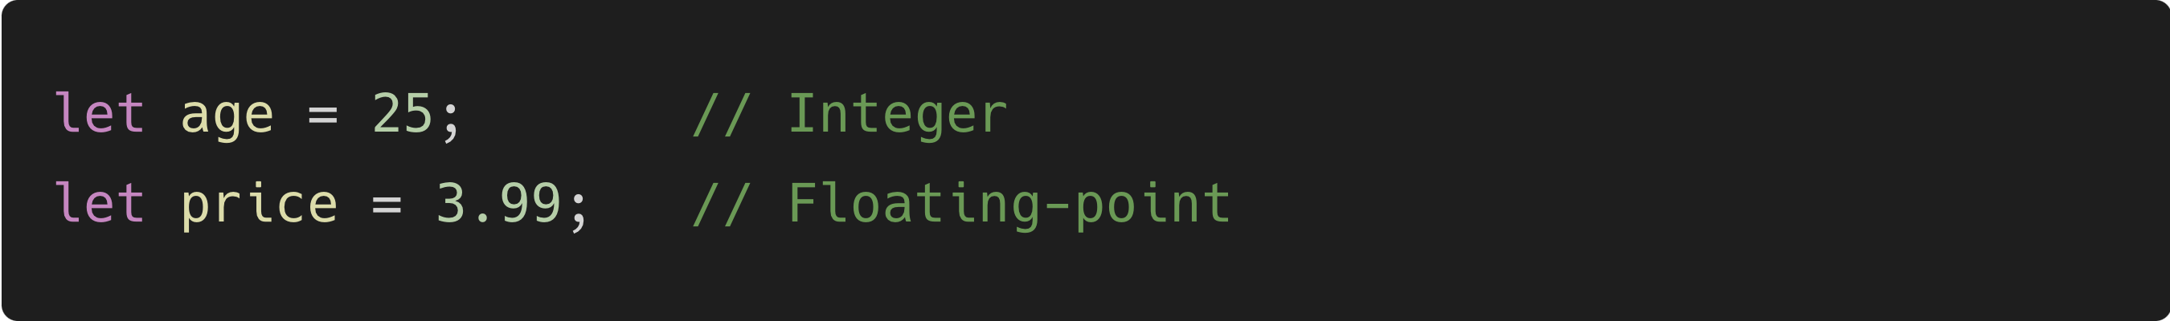
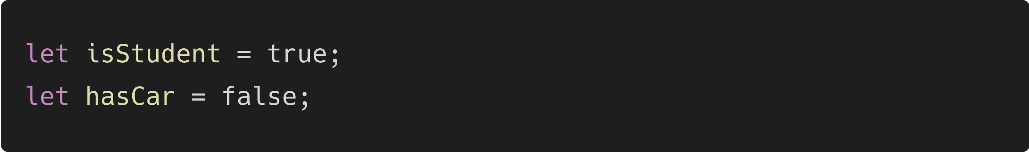
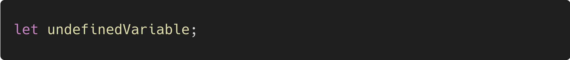
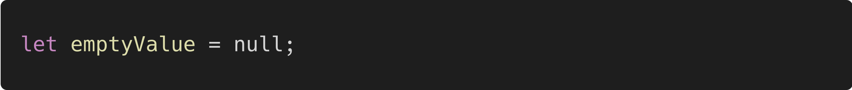
Data Types
String: Represents sequences of characters.
Number: Represents both integer and floating-point numbers.
Boolean: Represents true or false values.
Undefined: Represents a variable that has been declared but not assigned a value.
Null: Represents an intentional absence of any object value.

Slide 10
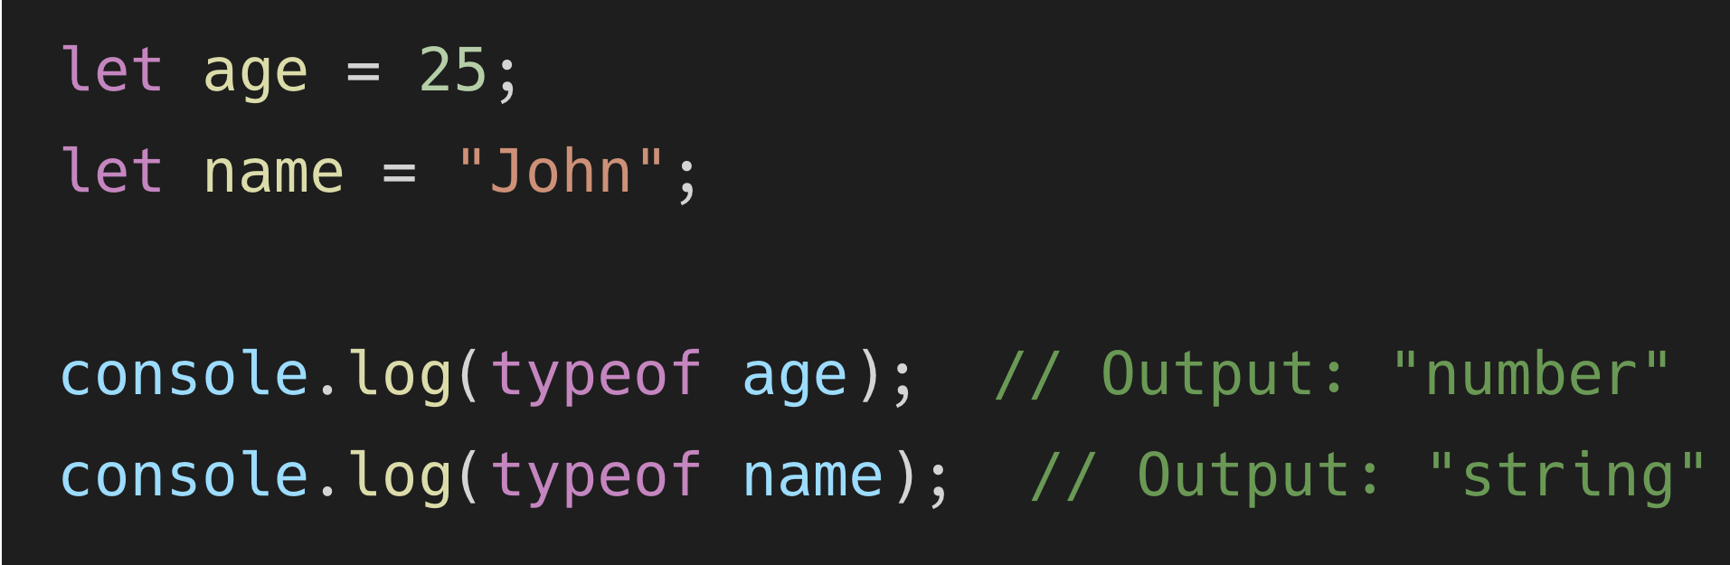
Typeof operator
Typeof operator is used to check the data type of a variable / value

Slide 11
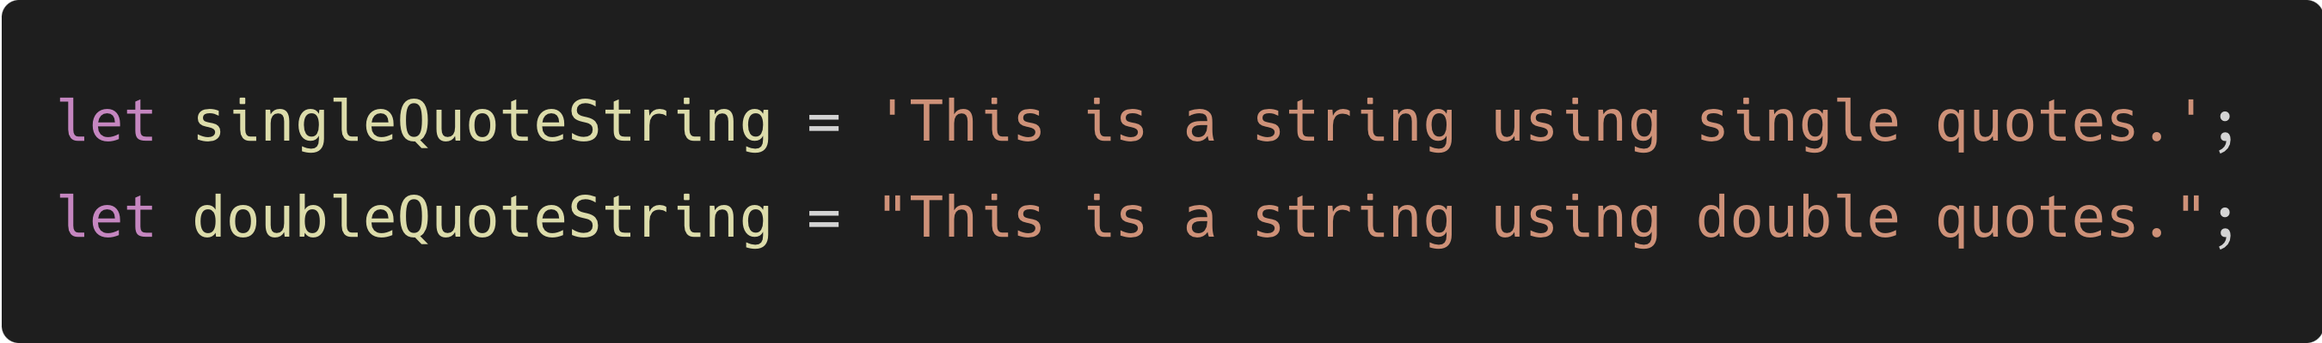
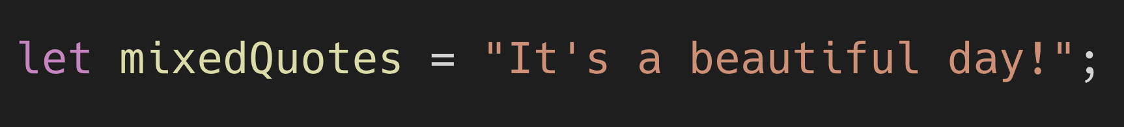
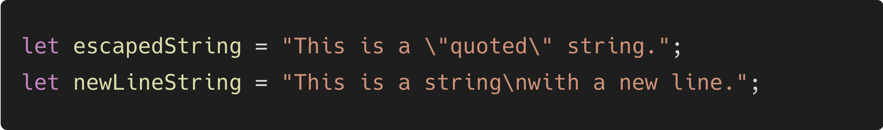
String Value Declaration (1)
Single Quotes (') and Double Quotes (")
You can use both single quotes and double quotes to create string literals. There's no functional difference between them; you can choose whichever you prefer.
You can use single quotes within double-quoted strings and vice versa
If you need to include special characters within strings, you can escape them using the backslash (\) character

Slide 12
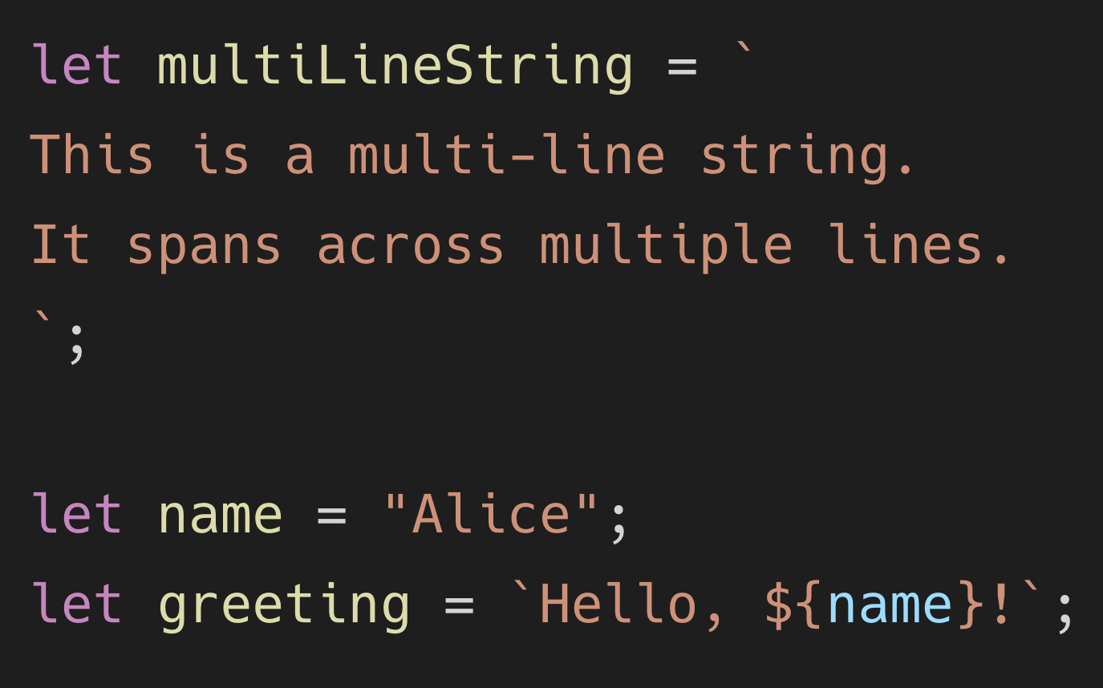
String Value Declaration (2)
Backticks (`)
Backticks provide more functionality than single or double quotes. They allow you to create multi-line strings and perform string interpolation (embedding expressions within strings).

Slide 13
Operators
Section 3

Slide 14
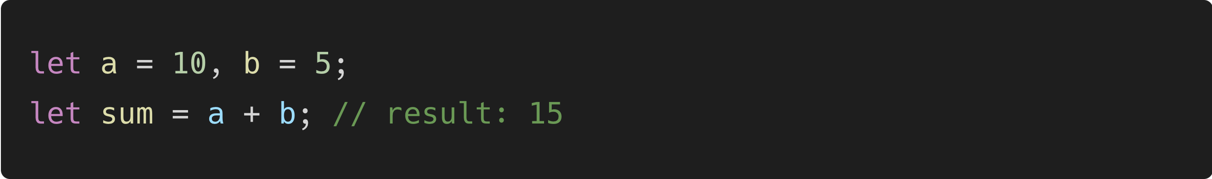
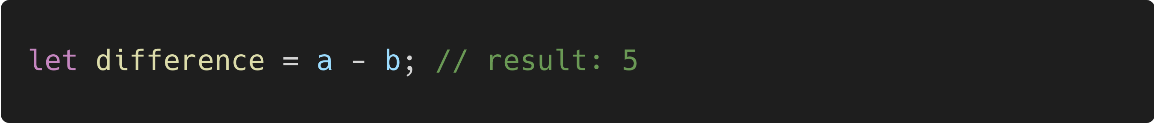
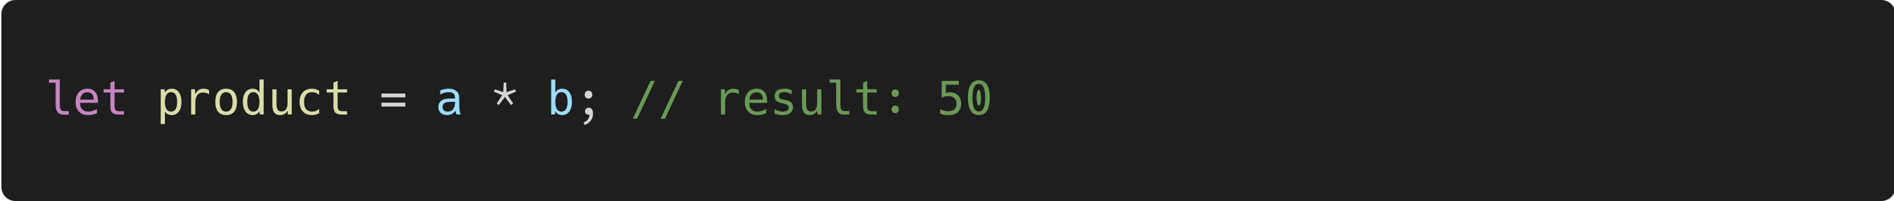
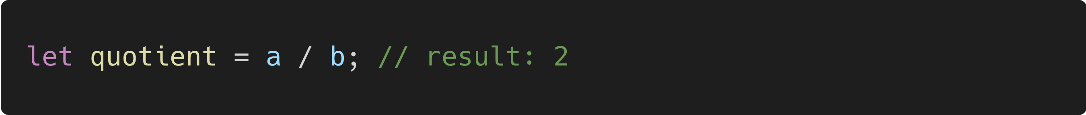
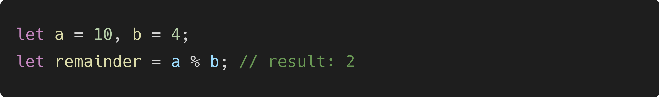
Arithmetic Operators
Operators | Function | Example
Addition (+) | Adds two values.
Subtraction (-) | Subtracts the right operand from the left operand.
Multiplication (*) | Multiplies two values.
Division (/) | Divides the left operand by the right operand.
Modulus (%) | Returns the remainder of the division.

Slide 15
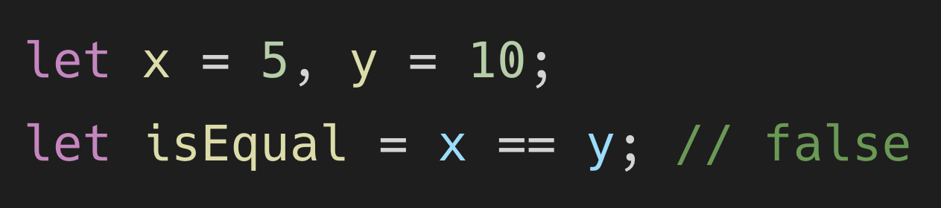
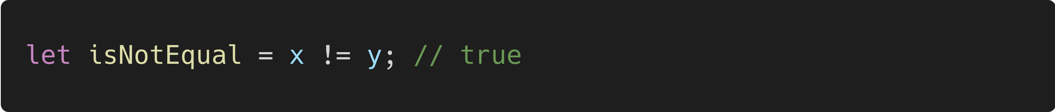
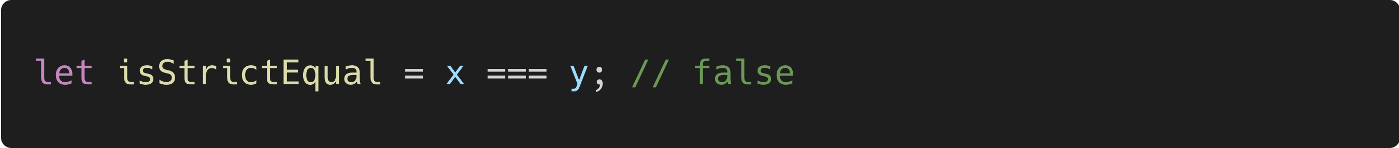
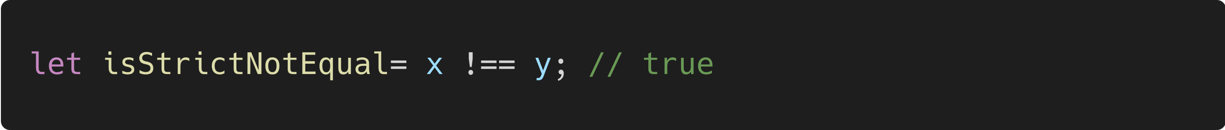
Comparison Operators
Operators | Function | Example
Equal to (==) | Compares if two values are equal.
Not equal to (!=) | Compares if two values are not equal.
Strict equal to (===) | Compares if two values are equal in both value and type.
Strict not equal to (!==) | Compares if two values are not equal in value or type.

Slide 16
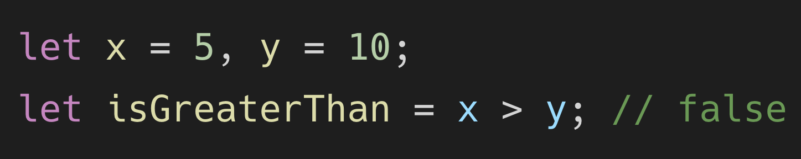
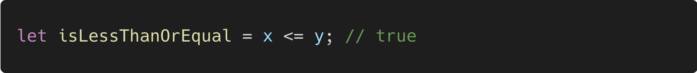
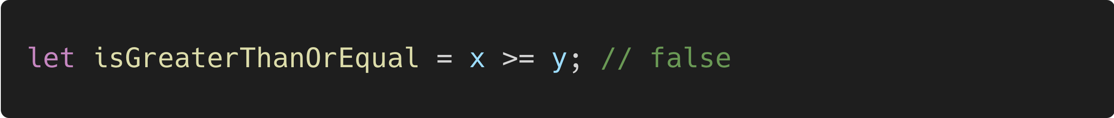
Comparison Operators (2)
Operators | Function | Example
Greater than (>) | Checks if the left operand is greater than the right operand
Less than (<) | Checks if the left operand is less than the right operand.
Greater than or equal to (>=) | Checks if the left operand is greater than or equal to the right operand.
Less than or equal to (<=) | Checks if the left operand is less than or equal to the right operand.

Slide 17
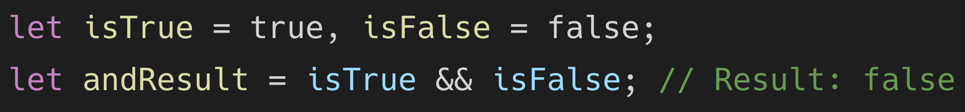
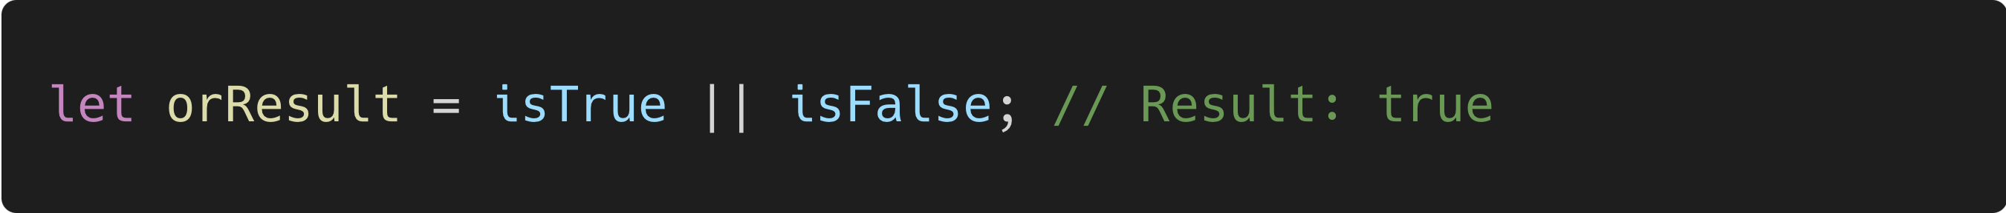
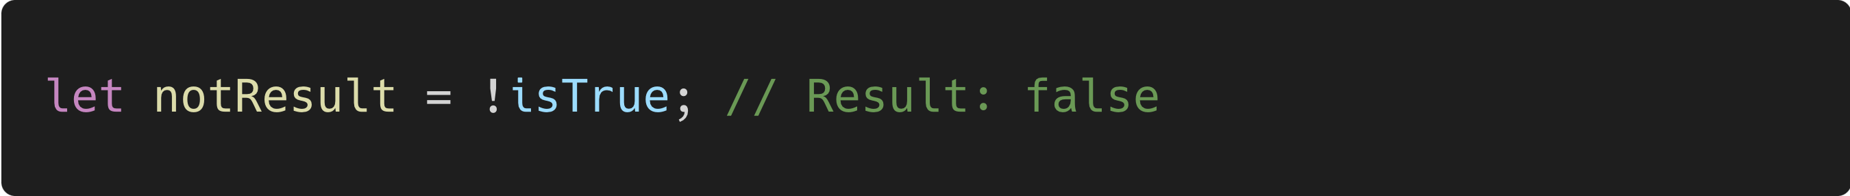
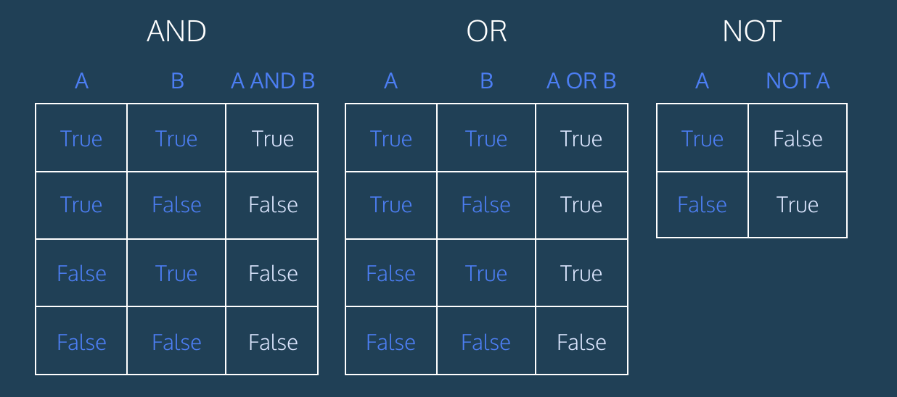
Logical Operators
Operators | Function | Example
Logical AND (&&) | Returns true if both operands are true.
Logical OR (||) | Returns true if at least one operand is true.
Logical NOT (!) | Inverts the boolean value of an operand.

Slide 18
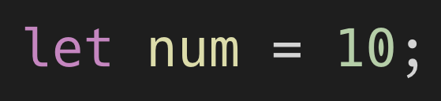
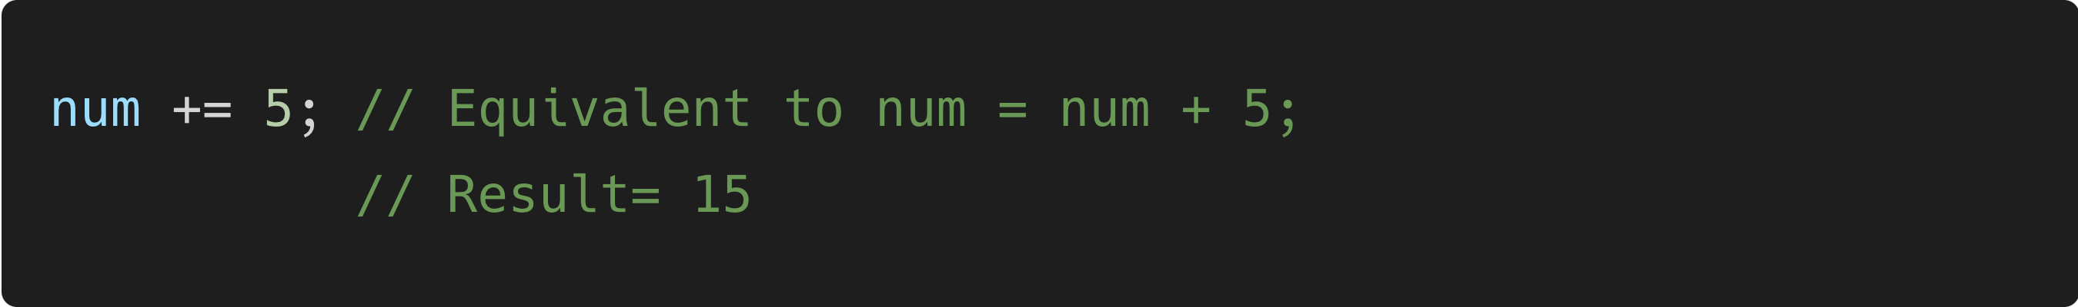
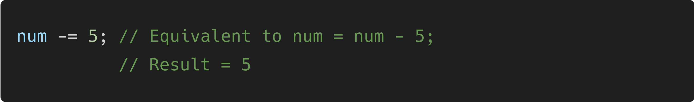
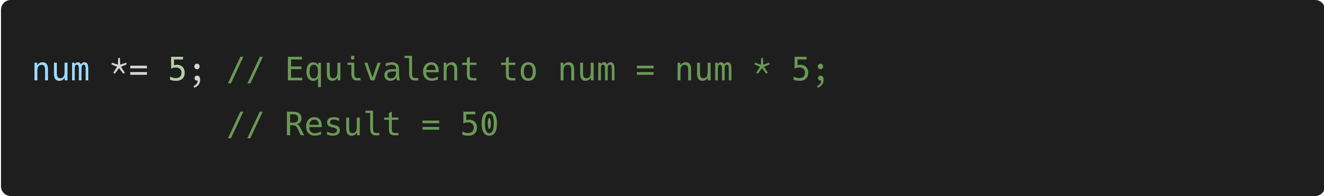


Assignment Operators
Operators | Function | Example
Assignment (=) | Assigns a value to a variable.
Add and Assign (+=) | Adds a value to a variable and assigns the result.
Subtract and Assign (-=) | Subtracts a value from a variable and assigns the result.
Multiply and Assign (*=) | Multiplies a variable by a value and assigns the result.
Divide and Assign (/=) | Divides a variable by a value and assigns the result.
Modulus and Assign (%=) | Calculates the modulus of a variable and assigns the result.

Slide 19
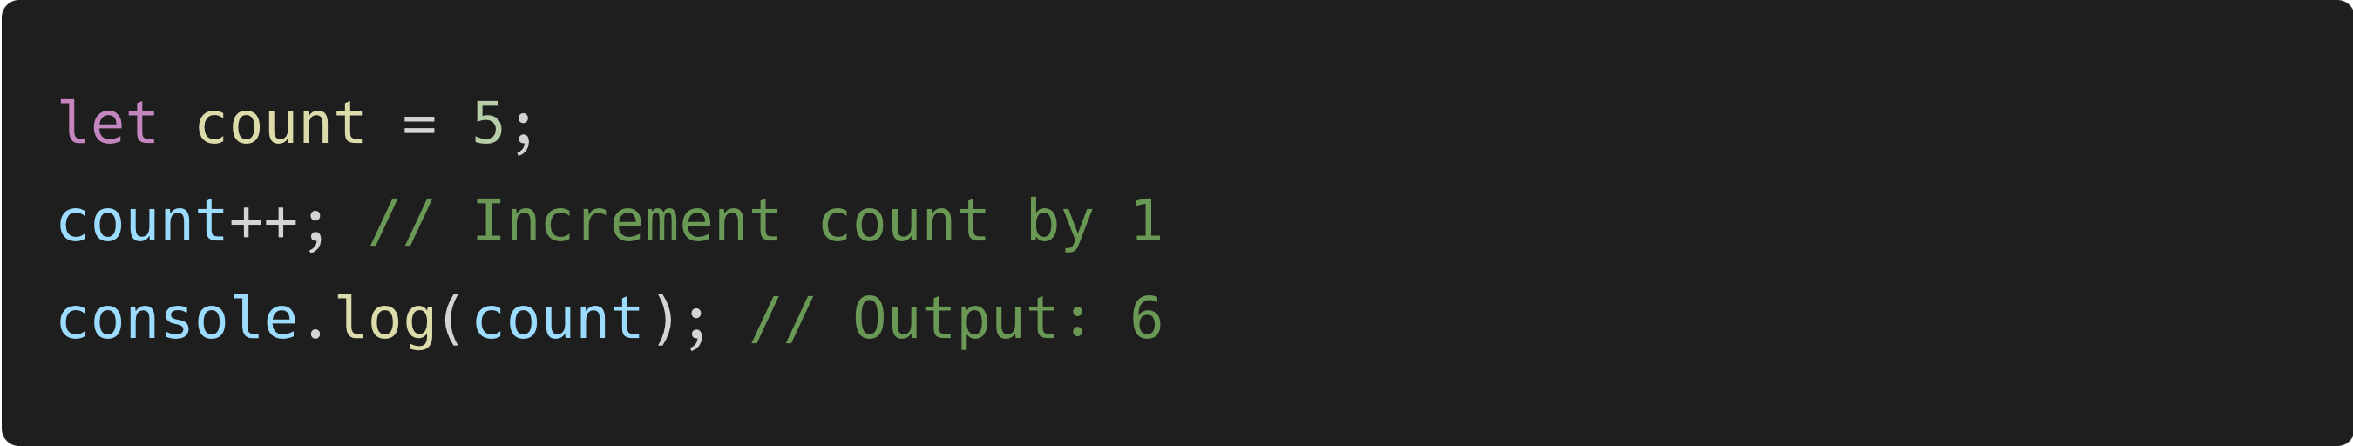
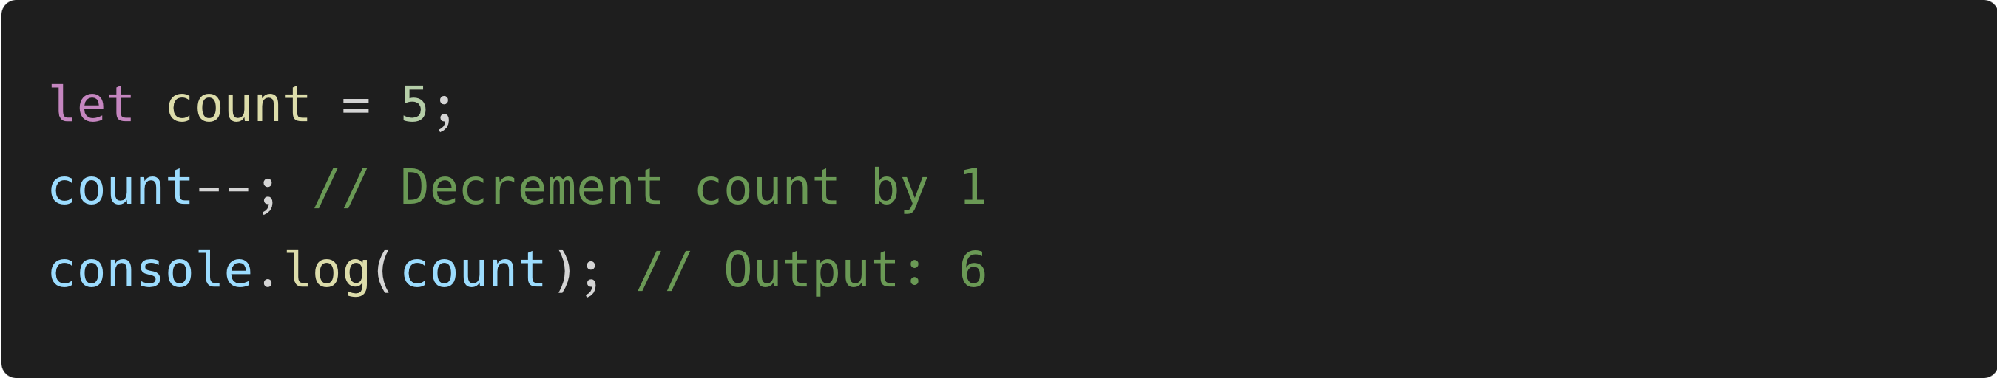
Unary Operators
Operators | Function | Example
Increment (++) | Increases value of a variable by 1.
Decrement (--) | Decreases value of a variable by 1.

Slide 20
String & Math Methods
Section 3

Slide 21
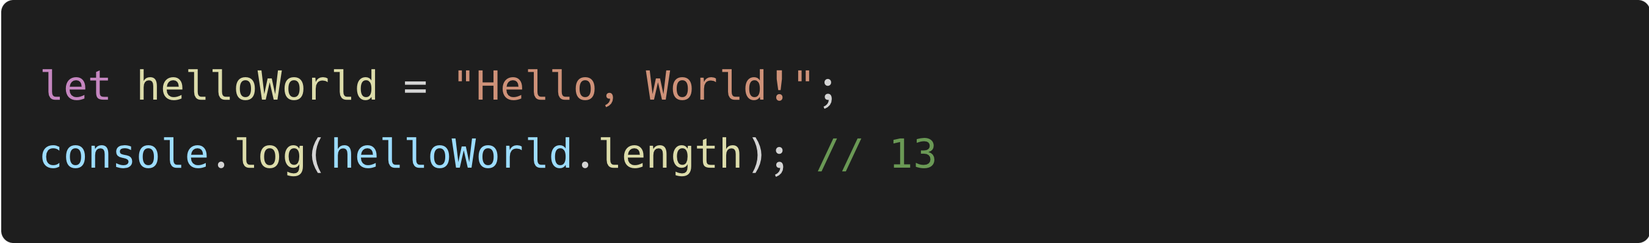
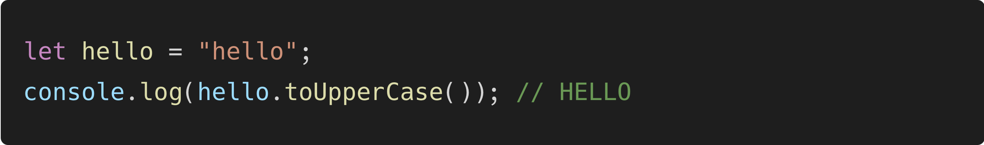
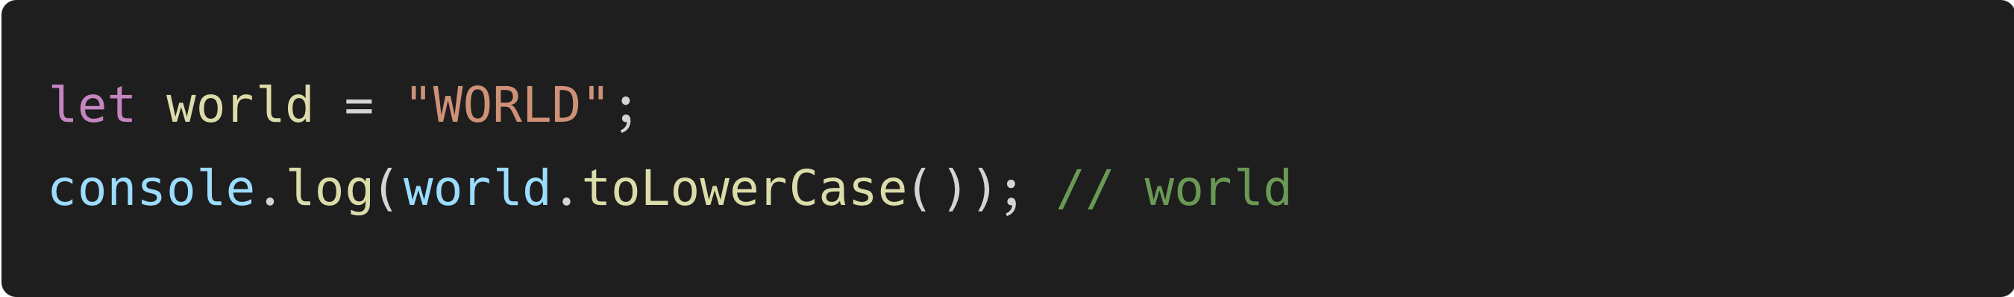
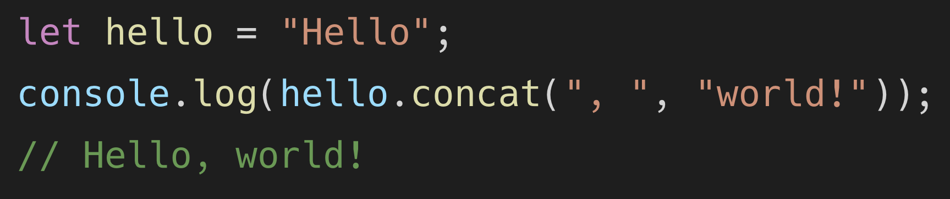
String Methods (1)
Methods | Function | Example
.length | Returns the number of characters in a string.
.toUpperCase() | Returns a new string with all characters converted to uppercase.
.toLowerCase() | Returns a new string with all characters converted to lowercase.
.concat(str1, str2, …) | Concatenates multiple strings together.

Slide 22
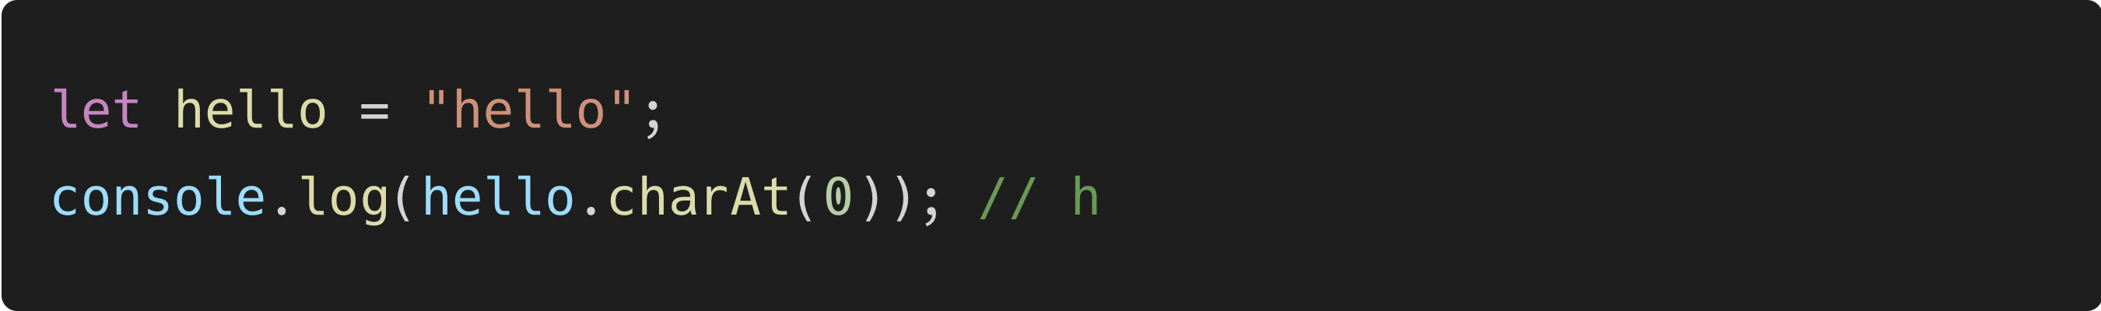
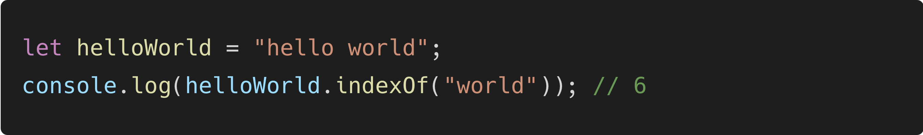

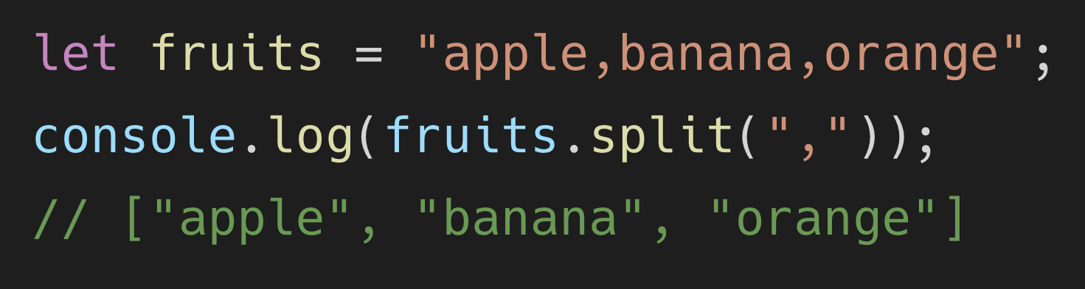
String Methods (2)
Methods | Function | Example
.charAt(index) | Returns the character at the specified index in the string.
.indexOf(substring) | Returns the index of the first occurrence of the specified substring. Returns -1 if not found.
.substring(startIndex, endIndex) | Returns a new substring that starts from startIndex and ends before endIndex.
.split(separator) | Splits the string into an array of substrings using the specified separator.

Slide 23
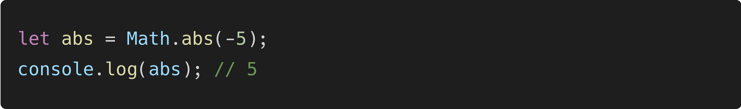
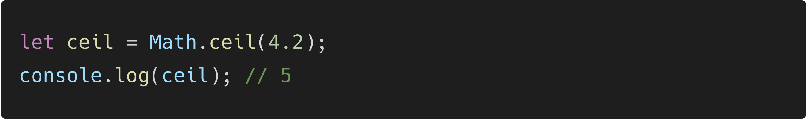
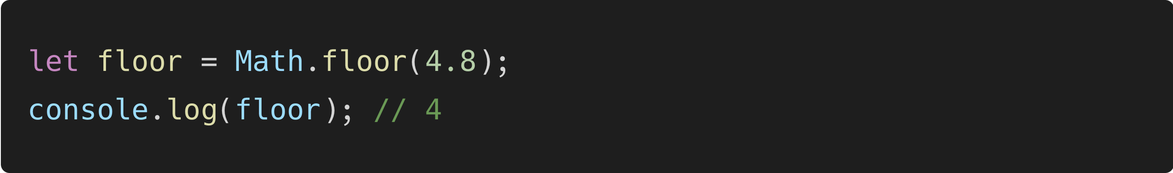
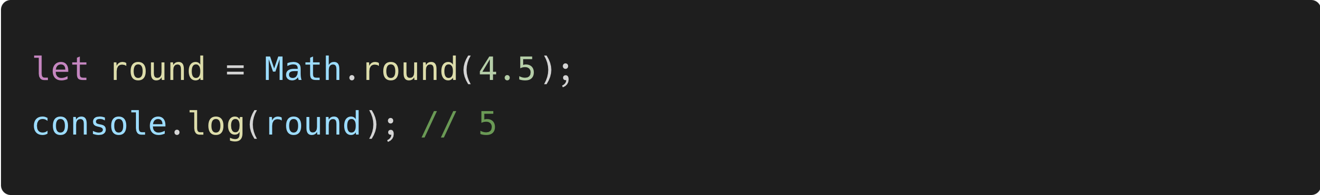
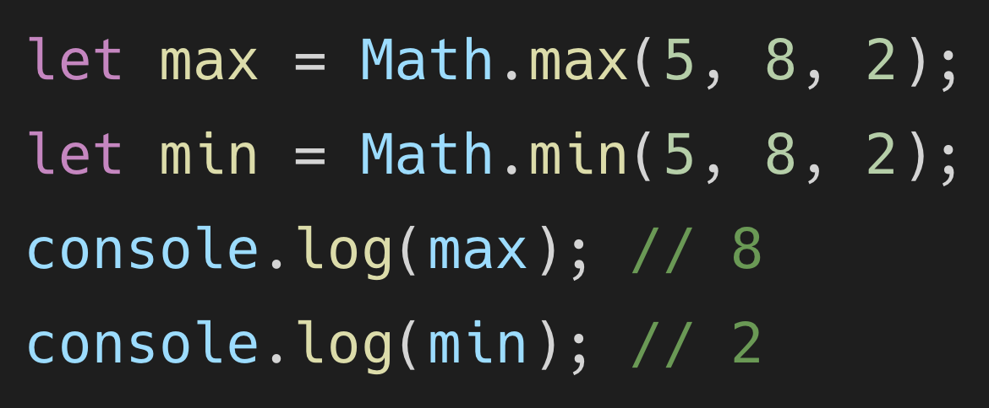
Math Methods (1)
Methods | Function | Example
Math.abs(x) | Returns the absolute value of a number ‘x’
Math.ceil(x) | Reutrns the smallest integer greater than or equal to ‘x’
Math.floor(x) | Returns the largest integer less than or equal to ‘x’
Math.round(x) | Rounds a number to the nearest integer.
Math.max(x1, x2, …) & Math.min(x1, x2, …) | Returns the maximum or minimum value among the provided numbers.

Slide 24




Math Methods (2)
Methods | Function | Example
Math.random() | Returns a random floating-point number between 0 (inclusive) and 1 (exclusive)
Math.sqrt(x) | Returns the square root of a non-negative number ‘x’
Math.pow(base, exponent) | Returns the result of raising ‘base’ to the power of ‘exponent’
Math.PI | A property representing the mathematical constant π (pi).

Slide 25


Type Converter
Number converter
String converter
Methods | Function | Example
Number(x) | Converts a string and returns returns an integer or a float number based on the number
parseInt(x) | Parses a string ‘x’ and returns an integer point number
parseFloat(x) | Parses a string ‘x’ and returns a floating point number
Methods | Function | Example
String(value) or value.toString() | Converts any value into a string

Slide 26
Conditional Statement
Section 4

Slide 27


If, else, and else if Statement
If statement is one of the keys used for branching. Branching means we can execute certain program code when conditions are met. Almost all of programming language supported if, else, and else if statement, even Microsoft Excel too.
If statement
If + else statement

Slide 28

If, else, and else if Statement (2)
If statement is one of the keys used for branching. Branching means we can execute certain program code when conditions are met. Almost all of programming language supported if, else, and else if statement, even Microsoft Excel too.
If + else if + else statement

Slide 29

Switch Statement
Switch statement is one of the keys used for branching, same as an if statement, but operation and used most simplify. Switch statement commonly used for conditions with 1 value which want to validate.
Notes:
break = for stopping block of code certain if the case is met.
default = block of code in default could run if any case isn't met.

